Slide 1


Cough Audio Signal Classification
By: Yevheniya Shevchenko
Thank you to my mentor
Capstone Presentation

Slide 2

Problem Identification
Why is this useful?
Respiratory diseases are becoming more prevalent, how can we support doctors in the diagnostic process?
Take some of the strain off of the medical field
Benefit companies that are going into the telehealth market
Notes:
Medical Field - people wait to long to get a diagnostic

Slide 3
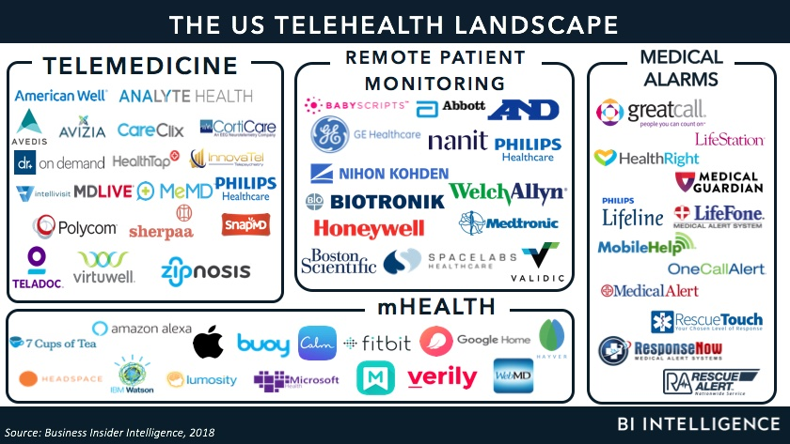
Who might care?

Slide 4
Data Exploration & Wrangling
Dataset with 25,000 crowdsourced cough recordings
2,800 recordings are labeled by expert physicians
Folder format
.ogg & .webm files → .wav
Dimensionality reduction of physician diagnosis
Missing values

Slide 5
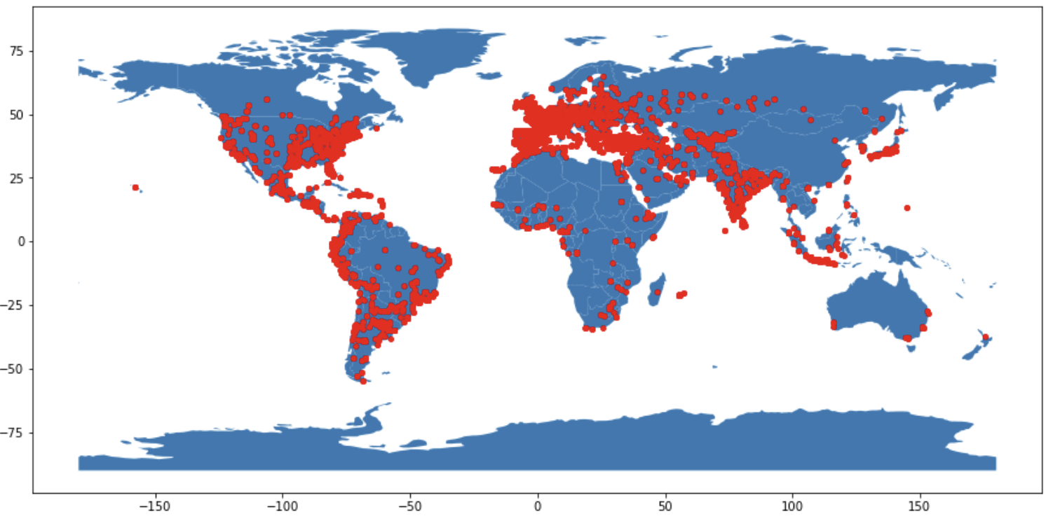

Slide 6
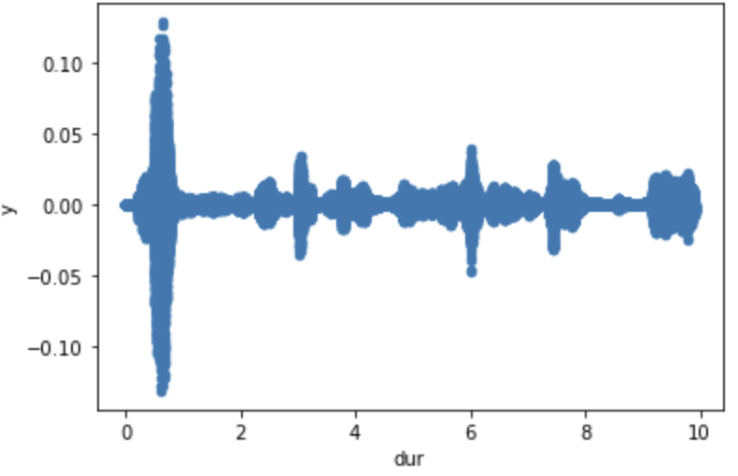
Exploratory Data Analysis
Sound data features:
RMS
Spectral Centroid
Spectral Bandwidth
Spectral Rolloff
Zero Crossing Rate
Mel Frequency Cepstral Coefficient (mfcc)
Notes:
Why I chose to use the average and the minimum values

Slide 7
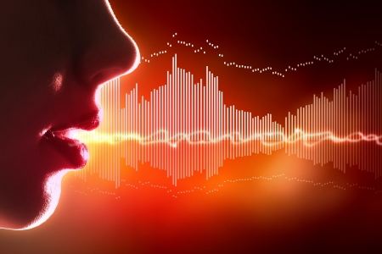
Modeling Overview
Type: Supervised Model
Data Preprocessing:
Label encoding
Data Splitting into training and test sets
Binary Classification: 0 for No COVID, 1 for COVID
Highly Imbalanced Data
Tools: Python sklearn
Notes:
Hybrid model - supervised and unsupervised (labeled and unlabeled data)
Mention what the target variables where

Slide 8
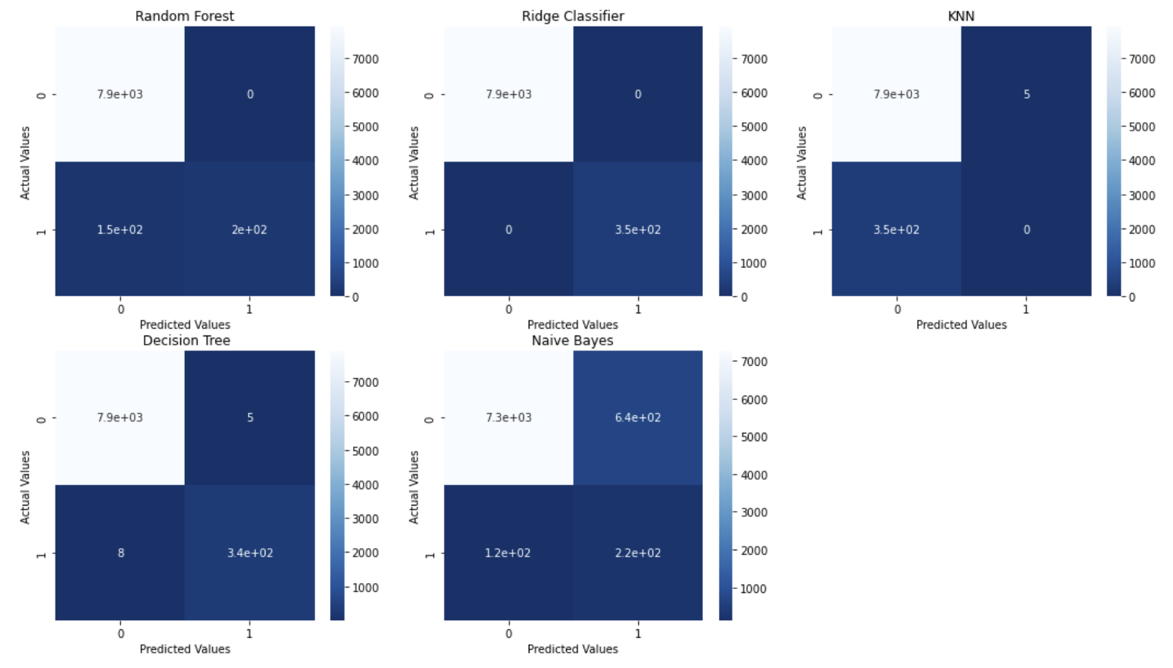
7900
0
7900
0
7900
5
150
200
0
350
350
0
7900
5
7300
640
8
340
120
220
Notes:
Why these models? What benefits do they have?

Slide 9
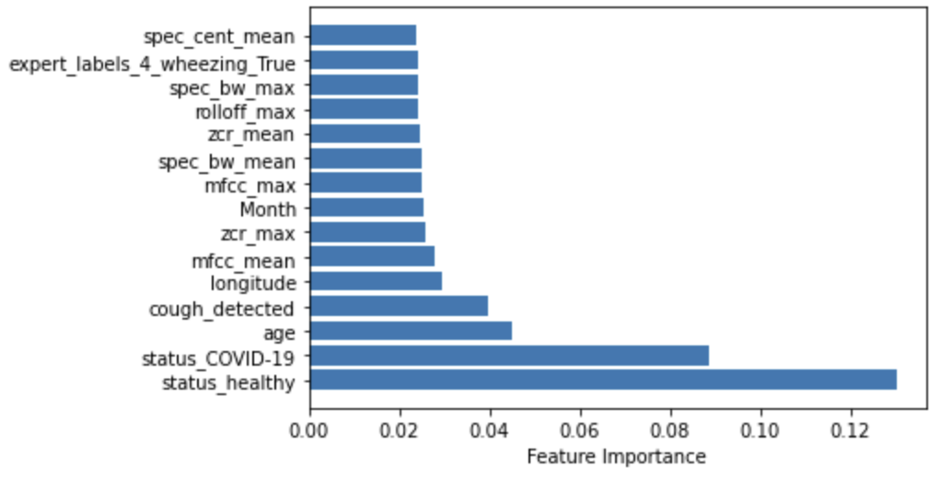
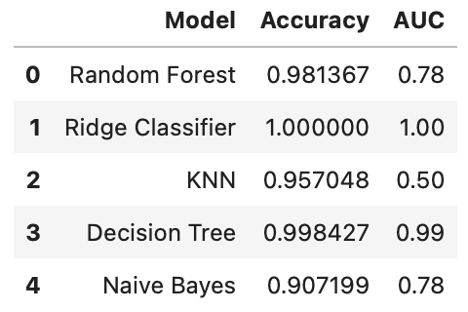
Feature Leakage & Next Steps
Notes:
Area under the ROC curve - performance across all possible classification thresholds
Measures how well predictions are ranked

Slide 10
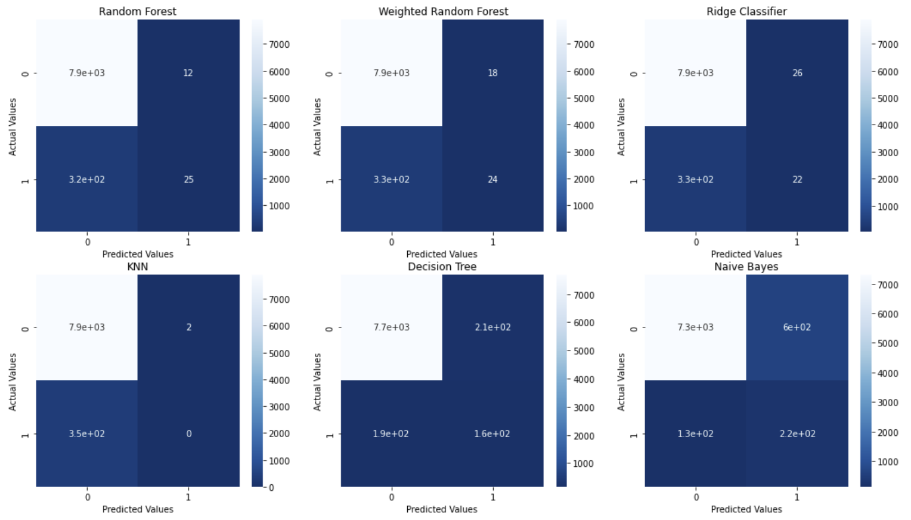
7900
12
7900
18
7900
26
320
25
330
24
330
22
7900
2
7700
210
7300
600
350
0
190
160
130
220
Notes:
Added weighted random forest

Slide 11
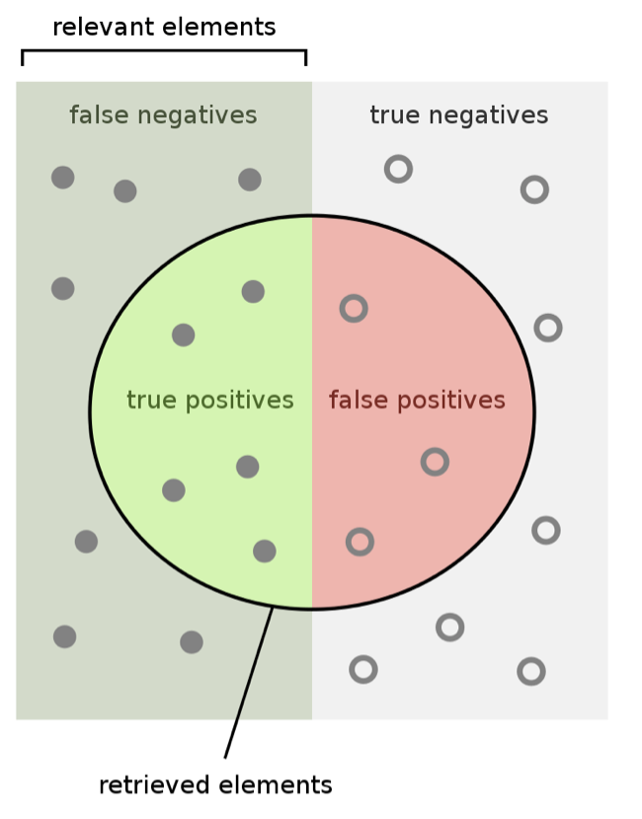
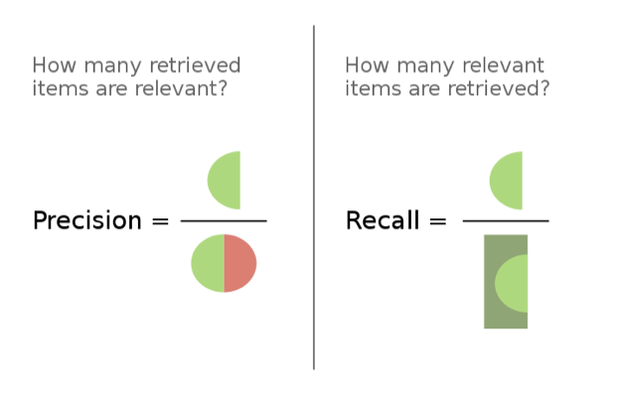
https://en.wikipedia.org/wiki/Precision_and_recall

Slide 12
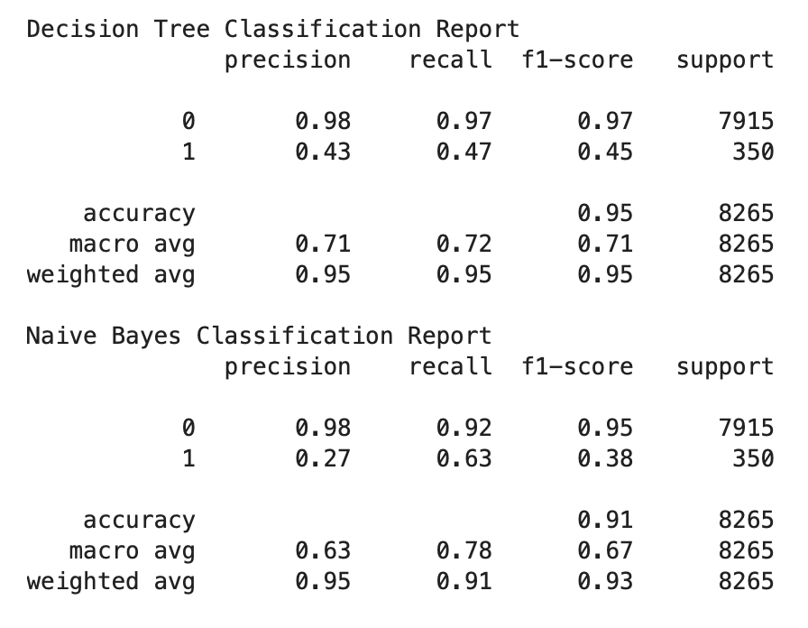

Slide 13
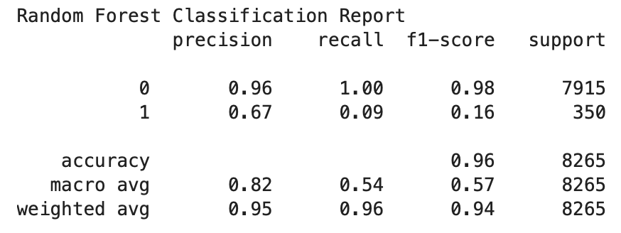
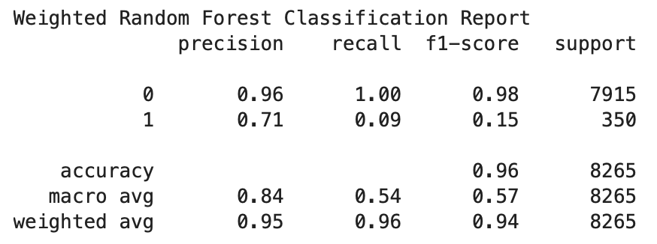

Slide 14
Recommendations
Sensitivity and specificity performance metrics
Importance of the cough_detected feature
Testing other combinational variables with hyperparameter tuning for sound features
Batch per iteration while training

